Slide 1
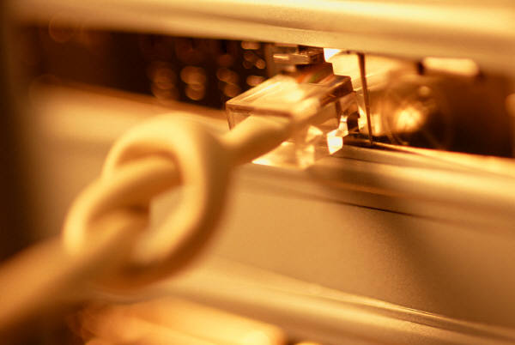
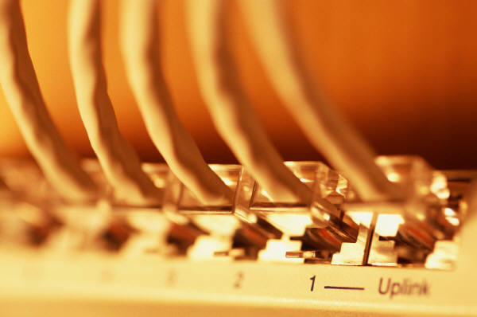

The Basics of Computer Networking
Notes:
I tried to keep the colors oranges, tans, and black for consistency throughout my presentation. I also felt a border throughout my project would make it stand out more. I kept the font at Arial throughout the presentation. The only change that I used was to bold it and highlight with colors here and there.

Slide 2
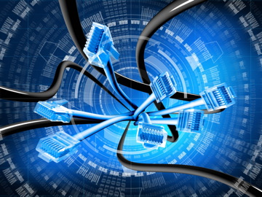
The Computer Network
Arguably, the greatest advancement in technology and communication over the past 20 years has been the development and advancement of the computer network. From emailing a friend to on-line bill paying to downloading data off the Internet to e-commerce, networking has made our world much smaller and changed the way we communicate forever.
Notes:
I especially liked this graphic. I felt it would be good for an introduction. While it wasn’t really in the color scheme, it was modern and caught people’s eye.

Slide 3
The Computer Network
What is a Computer Network
net·work: [net-wurk] – noun, a system containing any combination of computers, computer terminals, printers, audio or visual display devices, or telephones interconnected by telecommunication equipment or cables: used to transmit or receive information.
Notes:
I wanted to use the dictionary version of the network to be both informative as well as a gimmick to catch attention. If I had a text box under the main title or text box I tried to differentiate it by making in yellow and orange borders. I tried to do this throughout the presentation.

Slide 4
Navigation Links
Network Diagram – Basic Layout and map of a traditional computer network.
Network Types – Computer networks vary in shape and size depending on usage.
- WAN
- LAN
- Peer to Peer
Fiber Optic Cable – One of the Latest innovations in network cabling.
Switches and Hubs – The central device within a network that transmit data.
Servers – The central storage device for the names and locations of various data.
- IP Addresses
Topologies – The layouts of various network designs.
- Star
- Bus
- Ring
Firewalls – The network software that keeps destructive forces from a network.
Routers – The device that let messages flow between networks.
Wireless Networks - Allows computers to be moved without wires or cables.
The Internet – The world’s largest network.
References
Notes:
I used this page to help explain the navigational links. Being the networking is foreign to so many, I felt this might be effective.

Slide 5
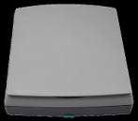




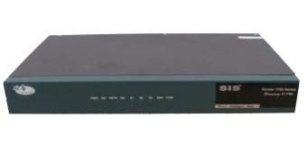
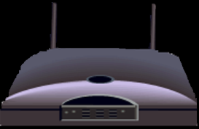
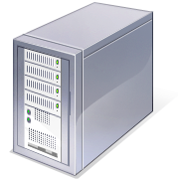

The Network Diagram
(Click on the Words Below and Learn More About Each Component)
Wired Network
PC
Firewall
The Internet
Fiber Optic Network Cable
Router
Switch
Server
Other LANS
Wireless Network
Notes:
I wanted to present this diagram to help the viewer visually understand how a computer network was set-up. I linked each component to the same text links throughout the project.

Slide 6

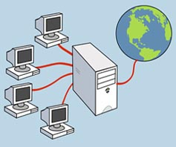
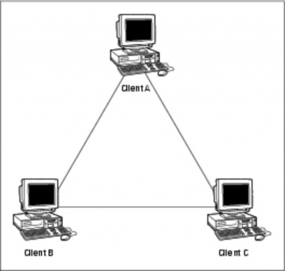
The Three Types of Networks
Navigation
Network Diagram
Network Types
- WAN
- LAN
- Peer to Peer
Fiber Optic Cable
Switches and Hubs
Servers
- IP Addresses
Topologies
- Star
- Bus
- Ring
Firewalls
Routers
Wireless Networks
The Internet
References
WIDE AREA
LOCAL AREA
PEER TO PEER
Notes:
I used this slide as a Introduction to the different types of networks. I tried to let the graphics do the talking on this slide. I elaborated more on each network type on subsequent slides.

Slide 7
Wide Area Network
Navigation
Network Diagram
Network Types
- WAN
- LAN
- Peer to Peer
Fiber Optic Cable
Switches and Hubs
Servers
- IP Addresses
Topologies
- Star
- Bus
- Ring
Firewalls
Routers
Wireless Networks
The Internet
References
A Wide Area Network exist over a large area
Data travels through telephone or cable lines
Usually requires a Modem
The world’s largest Wide Area Network in the Internet
Notes:
I kept the graphic the same as the previous graphic representing the Wide Area Network in hopes of creating a degree familiarity. I also include some basic facts about it.

Slide 8
Local Area Network
Navigation
Network Diagram
Network Types
- WAN
- LAN
- Peer to Peer
Fiber Optic Cable
Switches and Hubs
Servers
- IP Addresses
Topologies
- Star
- Bus
- Ring
Firewalls
Routers
Wireless Networks
The Internet
References
A Local Area Network spans a relatively small area
LAN are usually confined to one building or a group of buildings
Data travel between network devices via network cables.
The most common type of Local Area Network is called Ethernet
Notes:
I kept the graphic the same as the previous graphic representing the Local Area Network in hopes of creating a degree familiarity. I also include some basic facts about it.

Slide 9
Peer to Peer Network
Navigation
Network Diagram
Network Types
- WAN
- LAN
- Peer to Peer
Fiber Optic Cable
Switches and Hubs
Servers
- IP Addresses
Topologies
- Star
- Bus
- Ring
Firewalls
Routers
Wireless Networks
The Internet
References
Usually very small networks
Each workstation has equivalent capabilities and responsibilities
Does not require a switch or a hub.
These types of networks do not perform well under heavy data loads.
Notes:
I kept the graphic the same as the previous graphic representing the Peer to Peer Area Network in hopes of creating a degree familiarity. I also include some basic facts about it.

Slide 10
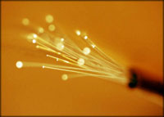
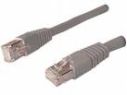
Fiber Optic Cable
Navigation
Network Diagram
Network Types
- WAN
- LAN
- Peer to Peer
Fiber Optic Cable
Switches and Hubs
Servers
- IP Addresses
Topologies
- Star
- Bus
- Ring
Firewalls
Routers
Wireless Networks
The Internet
References
Standard Network Copper Cable
Reduces interference in the network
Transmit data faster than copper network cable
Allows for more bandwidth
Smaller and more fragile than copper cable
Notes:
I felt this fiber optic cable graphic was a great graphic in that it, not only showed the fiber optic glass cables but, the colors fit in well with my project. I also wanted to show a small picture of a traditional wire cable just to contrast the two.

Slide 11
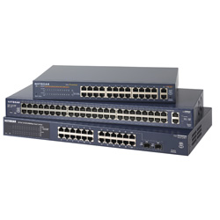
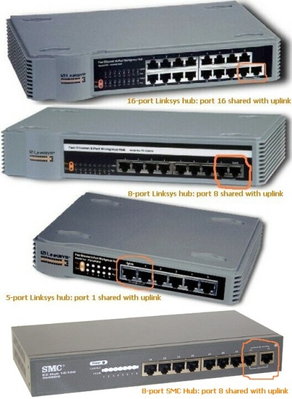
Switches and Hubs
Navigation
Network Diagram
Network Types
- WAN
- LAN
- Peer to Peer
Fiber Optic Cable
Switches and Hubs
Servers
- IP Addresses
Topologies
- Star
- Bus
- Ring
Firewalls
Routers
Wireless Networks
The Internet
References
Network Switches
Network Hubs
Data travels faster through switches because data is not sequenced as it is in a hub
The information is more secure when it passes through a switch as opposed to a hub.
Information travels more efficiently through a switch because travels directly to it’s destination as opposed to being broadcast to all PC’s on the network hub.
Notes:
I used the same principle with switches and hubs as I did with the fiber optic cable in that I tried to contrast the newer component (switches) with the older ones (hubs). They two are hard to differentiate and look very similar but, I tried to outline the components below.

Slide 12
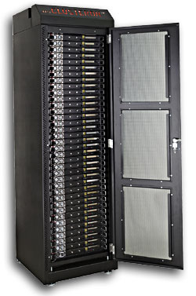
Servers
Users are connected to certain servers which will fulfill the required request.
There are 3 Principle Types of Servers
Print Servers
Contains the name and location of all printers that are on the Network
File Servers
Contain the location and names of the various drives, files, and folders on a Network
Web Servers
Contain the Programs, Files, and Internet Web Sites
Navigation
Network Diagram
Network Types
- WAN
- LAN
- Peer to Peer
Fiber Optic Cable
Switches and Hubs
Servers
- IP Addresses
Topologies
- Star
- Bus
- Ring
Firewalls
Routers
Wireless Networks
The Internet
References
Rack of Servers
Notes:
There is a lot of information that could be elaborated on in regards to servers but, I chose to make brief comments about Print, File, and Web servers. I tried to use contrasting colors to make it effective.

Slide 13
Web Servers
Navigation
Network Diagram
Network Types
- WAN
- LAN
- Peer to Peer
Fiber Optic Cable
Switches and Hubs
Servers
- IP Addresses
Topologies
- Star
- Bus
- Ring
Firewalls
Routers
Wireless Networks
The Internet
References
IP Addresses
“IP” stands for Internet Protocol. IP Addresses serve as the location of websites on the Internet as well as the workstations that are connected to the web. IP addresses are made up of four sets of numbers called “Octets”. There are two types of IP Addresses: Static and Temporary. Below is a description of both.
Static IP Addresses
Temporary IP Addresses
Static IP addresses are found only on servers and remain the same.
A Domain Name Server assigns a “human readable” web address to each static IP address to make it more user friendly.
Temporary IP addresses are found only on PC’s are constantly changing each time it is logged on.
Temporary IP addresses are assigned by an ISP (Internet Service Provider) each time it is logged on to the Internet.
Notes:
IP addresses tend to go along with servers, especially web servers in that they store data for websites. Once again there is a good deal of information on this slide and I might could have separated Static and Temporary IP addresses into separate slides but I felt a side by side comparison was effective.

Slide 14
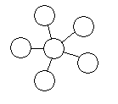
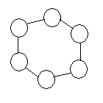

Network Topologies
Navigation
Network Diagram
Network Types
- WAN
- LAN
- Peer to Peer
Fiber Optic Cable
Switches and Hubs
Servers
- IP Addresses
Topologies
- Star
- Bus
- Ring
Firewalls
Routers
Wireless Networks
The Internet
References
Network Topology refers to the shape of a network, or the network's layout. How different nodes in a network are connected to each other and how they communicate are determined by the network's topology.
There are three basic topologies:
Star
Ring
Bus
Notes:
The topology section of my presentation may have been a little confusing for those who are not in the IT or networking field. I tried to explain the process and function of topologies using the three subsequent slides and the features of each topology.

Slide 15
Star Topology
Navigation
Network Diagram
Network Types
- WAN
- LAN
- Peer to Peer
Fiber Optic Cable
Switches and Hubs
Servers
- IP Addresses
Topologies
- Star
- Bus
- Ring
Firewalls
Routers
Wireless Networks
The Internet
References
All devices are connected to a central hub.
Nodes communicate across the network by passing data through the hub or switch.
Notes:
I wanted to beak each of these down so it could be explained and understood better. While topology diagrams can be easily understood in the IT field they may be a little hard to grasp to average person.

Slide 16
Ring Topology
Navigation
Network Diagram
Network Types
- WAN
- LAN
- Peer to Peer
Fiber Optic Cable
Switches and Hubs
Servers
- IP Addresses
Topologies
- Star
- Bus
- Ring
Firewalls
Routers
Wireless Networks
The Internet
References
All devices are connected to one another in the shape of a closed loop.
Each device is connected directly to two other devices, one on either side of it.
Notes:
I wanted to beak each of these down so it could be explained and understood better. While topology diagrams can be easily understood in the IT field they may be a little hard to grasp to average person.

Slide 17
Bus Topology
Navigation
Network Diagram
Network Types
- WAN
- LAN
- Peer to Peer
Fiber Optic Cable
Switches and Hubs
Servers
- IP Addresses
Topologies
- Star
- Bus
- Ring
Firewalls
Routers
Wireless Networks
The Internet
References
T
T
All devices are connected to a central cable, called the bus or backbone.
There are terminators at each end of the bus that stops the signal and keeps it from traveling backwards.
Notes:
I wanted to beak each of these down so it could be explained and understood better. While topology diagrams can be easily understood in the IT field they may be a little hard to grasp to average person.

Slide 18
Firewalls
Navigation
Network Diagram
Network Types
- WAN
- LAN
- Peer to Peer
Fiber Optic Cable
Switches and Hubs
Servers
- IP Addresses
Topologies
- Star
- Bus
- Ring
Firewalls
Routers
Wireless Networks
The Internet
References
A firewall is a software that can be loaded on to a network that can serve as a barrier that keeps destructive forces away from a network of computers.
Packets of data are analyzed against a set of criteria or standards called filters.
Filters block certain designated IP addresses.
Notes:
I used to same graphic from the network diagram to get my point across and hopefully, be able to use it to create some familiarity. I tried to keep the graphics and explanations easy to understand by anyone viewing my presentation.

Slide 19
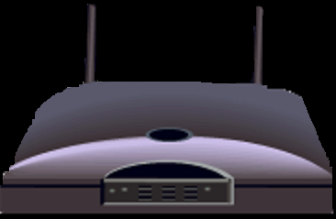
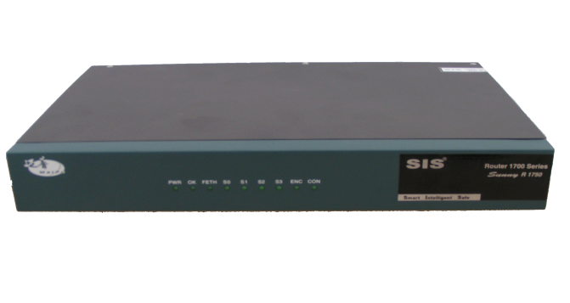
Routers
Navigation
Network Diagram
Network Types
- WAN
- LAN
- Peer to Peer
Fiber Optic Cable
Switches and Hubs
Servers
- IP Addresses
Topologies
- Star
- Bus
- Ring
Firewalls
Routers
Wireless Networks
The Internet
References
Standard Router
Wireless Router
Whether a Router is traditional or wireless, its purposes remain the same.
Routers are specialized computers that send your messages and those of every other Internet user speeding to their destinations along thousands of pathways.
Routers are crucial devices that let messages flow between networks, rather than within networks.
Notes:
Once again, I tried to pull graphics from the original network diagram. I had to alter the wireless router graphic in Photoshop to make it look better. I darken the and removed a white background to make it look consistent in relation to the standard router.

Slide 20
Wireless Networks
Navigation
Network Diagram
Network Types
- WAN
- LAN
- Peer to Peer
Fiber Optic Cable
Switches and Hubs
Servers
- IP Addresses
Topologies
- Star
- Bus
- Ring
Firewalls
Routers
Wireless Networks
The Internet
Allows for computers to be moved easily without having to worry about wires or cables
Walkie-Talkie Network
You would equip each computer with basically, a walkie-talkie.
You would give each computer a way to set whether it wants to transmit or receive.
A wireless network converts binary signal (0’s and 1’s) into a radio signal (series of beeps).
Notes:
I pull this graphic on the original network diagram. Use the radio waves to demonstrate that the network was wireless. I also wanted to notate a big advantage of wireless network by putting it in orange.

Slide 21
The Internet
Navigation
Network Diagram
Network Types
- WAN
- LAN
- Peer to Peer
Fiber Optic Cable
Switches and Hubs
Servers
- IP Addresses
Topologies
- Star
- Bus
- Ring
Firewalls
Routers
Wireless Networks
The Internet
References
How Information Travel Through the Internet
A page on the Internet—whether it's full of words, images or both—doesn't come to you in one shipment. It's translated into digital information, chopped into 1500 byte pieces called PACKETS, and sent to you like a puzzle that needs to be reassembled. Each part of the packet has a specific function:
Sequence ID
ID’s where the information belongs in relation to the rest of the information
Header
Provides the complete destination address for the packet
End of Message
ID’s the end of the packet
Data Block
The portion of the overall information carried by the packet
Notes:
I felt that although a lot of information was on this slide, I feel it was not too crowded and well places. I used color coding on the packet to help the reader determine where it should go.

Slide 22

The Internet
Navigation
Network Diagram
Network Types
- WAN
- LAN
- Peer to Peer
Fiber Optic Cable
Switches and Hubs
Servers
- IP Addresses
Topologies
- Star
- Bus
- Ring
Firewalls
Routers
Wireless Networks
The Internet
References
The simplest definition of the Internet is that it's a network of computer networks
Notes:
I used three slides to go over the Internet. I wanted to start of the first slide with a basic statement but, it would have an impact on the viewer.

Slide 23
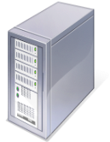

The Internet
Navigation
Network Diagram
Network Types
- WAN
- LAN
- Peer to Peer
Fiber Optic Cable
Switches and Hubs
Servers
- IP Addresses
Topologies
- Star
- Bus
- Ring
Firewalls
Routers
Wireless Networks
The Internet
References
How Information Travel Through the Internet
When you connect to a Web site through an ISP and start exchanging information, there isn't a fixed connection between your computer and the Web server computer hosting the Web site. Instead, information is exchanged using the best possible path at that particular time. Special computers called routers determine these paths, avoiding slow links and favoring fast ones.
Your Computer
ISP
Web Servers
Routers
Notes:
I would have like to use some animation for this but it would have been very difficult so I went ahead and use green and red colors to represent the flowing in data into the Internet and the flowing of data out of the Internet. I wanted to stress that data does not take the same path all the time when traveling to and from the Internet.

Slide 24
References
Intel Corporation, (2004). www.intel.com. Retrieved May 11, 2007, from .The Journey Inside: The Internet. website: http://www97.intel.com/discover/JourneyInside/TJI_Internet/default.aspx
Webdopedia (2007). http://www.webopedia.com/. Retrieved May 11, 2007, online dictionary and search engine you need for computer and Internet technology definitions. http://www.webopedia.com/.
Notes:
The two main references that I pulled information from was Intel Corp. and a Webdopedia website which provided definitions and descriptions of various network components.

